Slide 1
Module 2
Data Link Layer:
Error Detection and Correction: Introduction, Block Coding, Cyclic Codes. Data link control: DLC Services: Framing, Flow Control, Error Control, Connectionless and Connection Oriented, Data link layer protocols, High Level Data Link Control.

Slide 2
The TCP/IP protocol suite does not define any protocol in the data-link layer or physical layer.
These two layers are territories of networks that when connected make up the Internet.
These networks, wired or wireless, provide services to the upper three layers of the TCP/IP suite.
This may give us a clue that there are several standard protocols in the market today.
For this reason, we discuss the data-link layer in several chapters.
This chapter is an introduction that gives the general idea and common issues in the data-link layer that relate to all networks

Slide 3
INTRODUCTION
The Internet is a combination of networks glued together by connecting devices (routers or switches).
If a packet is to travel from a host to another host, it needs to pass through these networks.
Figure 9.1 shows the same scenario we discussed in Chapter 3, but we are now interested in communication at the data-link layer.
Communication at the data-link layer is made up of five separate logical connections between the data-link layers in the path

Slide 4
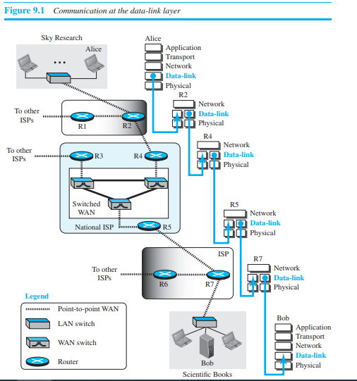

Slide 5
The data-link layer at Alice’s computer communicates with the data-link layer at router R2.
The data-link layer at router R2 communicates with the data-link layer at router R4, and so on. Finally, the data-link layer at router R7 communicates with the data-link layer at Bob’s computer.
Only one data-link layer is involved at the source or the destination, but two data-link layers are involved at each router.
The reason is that Alice’s and Bob’s computers are each connected to a single network, but each router takes input from one network and sends output to another network.
Note that although switches are also involved in the data-link-layer communication, for simplicity we have not shown them in the figure.

Slide 6
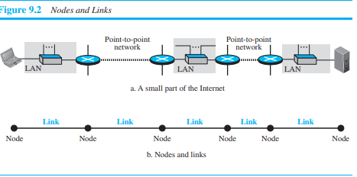
Nodes and Links
Communication at the data-link layer is node-to-node. A data unit from one point in the Internet needs to pass through many networks (LANs and WANs) to reach another point.
Theses LANs and WANs are connected by routers.
It is customary to refer to the two end hosts and the routers as nodes and the networks in between as links.
Figure 9.2 is a simple representation of links and nodes when the path of the data unit is only six nodes.
The first node is the source host; the last node is the destination host. The other four nodes are four routers. The first, the third, and the fifth links represent the three LANs; the second and the fourth links represent the two WANs.

Slide 7
Error Detection and Correction
Networks must be able to transfer data from one device to another with acceptable accuracy.
For most applications, a system must guarantee that the data received are identical to the data transmitted.
Any time data are transmitted from one node to the next, they can become corrupted in passage.
Many factors can alter one or more bits of a message. Some applications require a mechanism for detecting and correcting errors.
Some applications can tolerate a small level of error. For example, random errors in audio or video transmissions may be tolerable, but when we transfer text, we expect a very high level of accuracy.
At the data-link layer, if a frame is corrupted between the two nodes, it needs to be corrected before it continues its journey to other nodes.
However, most link-layer protocols simply discard the frame and let the upper-layer protocols handle the retransmission of the frame.
Some multimedia applications, however, try to correct the corrupted frame.

Slide 8
INTRODUCTION
Let us first discuss some issues related, directly or indirectly, to error detection and correction.
Types of Errors Whenever bits flow from one point to another, they are subject to unpredictable changes because of interference.
This interference can change the shape of the signal. The term single-bit error means that only 1 bit of a given data unit (such as a byte, character, or packet) is changed from 1 to 0 or from 0 to 1.
The term burst error means that 2 or more bits in the data unit have changed from 1 to 0 or from 0 to 1. Figure 10.1 shows the effect of a single-bit and a burst error on a data unit.

Slide 9
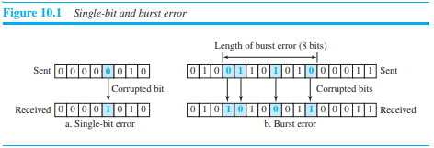
A burst error is more likely to occur than a single-bit error because the duration of the noise signal is normally longer than the duration of 1 bit, which means that when noise affects data, it affects a set of bits.
The number of bits affected depends on the data rate and duration of noise.
For example, if we are sending data at 1 kbps, a noise of 1/100 second can affect 10 bits; if we are sending data at 1 Mbps, the same noise can affect 10,000 bits.

Slide 10
Redundancy
The central concept in detecting or correcting errors is redundancy. To be able to detect or correct errors, we need to send some extra bits with our data.
These redundant bits are added by the sender and removed by the receiver.
Their presence allows the receiver to detect or correct corrupted bits.
Detection versus Correction
The correction of errors is more difficult than the detection. In error detection, we are only looking to see if any error has occurred.
The answer is a simple yes or no.
We are not even interested in the number of corrupted bits. A single-bit error is the same for us as a burst error.
In error correction, we need to know the exact number of bits that are corrupted and, more importantly, their location in the message.
The number of errors and the size of the message are important factors.
If we need to correct a single error in an 8-bit data unit, we need to consider eight possible error locations; if we need to correct two errors in a data unit of the same size, we need to consider 28 (permutation of 8 by 2) possibilities.
You can imagine the receiver’s difficulty in finding 10 errors in a data unit of 1000 bits.

Slide 11
Coding
Redundancy is achieved through various coding schemes.
The sender adds redundant bits through a process that creates a relationship between the redundant bits and the actual data bits.
The receiver checks the relationships between the two sets of bits to detect errors.
The ratio of redundant bits to data bits and the robustness of the process are important factors in any coding scheme.
We can divide coding schemes into two broad categories: block coding and convolution coding.
In this book, we concentrate on block coding; convolution coding is more complex and beyond the scope of this book.

Slide 12
BLOCK CODING
In block coding, we divide our message into blocks, each of k bits, called data words.
We add r redundant bits to each block to make the length n = k + r. The resulting n-bit blocks are called code words.
How the extra r bits are chosen or calculated is something we will discuss later.
For the moment, it is important to know that we have a set of data words, each of size k, and a set of code words, each of size of n.
With k bits, we can create a combination of 2k data words; with n bits, we can create a combination of 2n code words. Since n > k, the number of possible code words is larger than the number of possible data words.
The block coding process is one-to-one; the same data word is always encoded as the same code word. This means that we have 2n − 2k code words that are not used.
We call these code words invalid or illegal. The trick in error detection is the existence of these invalid codes, as we discuss next.
If the receiver receives an invalid code word, this indicates that the data was corrupted during transmission.

Slide 13
Error Detection
How can errors be detected by using block coding?
If the following two conditions are met, the receiver can detect a change in the original code word.
The receiver has (or can find) a list of valid code words.
The original code word has changed to an invalid one.
Figure 10.2 shows the role of block coding in error detection. The sender creates code words out of data words by using a generator that applies the rules and procedures of encoding (discussed later).
Each code word sent to the receiver may change during transmission. If the received code word is the same as one of the valid code words, the word is accepted; the corresponding data word is extracted for use.
If the received code word is not valid, it is discarded.
However, if the code word is corrupted during transmission but the received word still matches a valid code word, the error remains undetected.

Slide 14
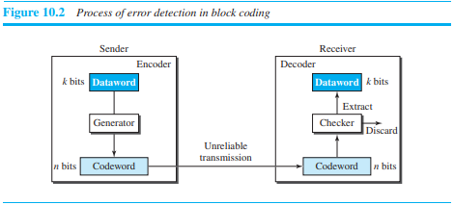

Slide 15
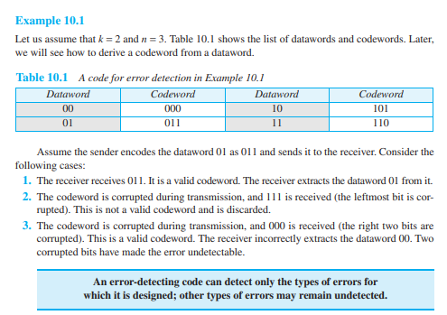

Slide 16
Hamming Distance
One of the central concepts in coding for error control is the idea of the Hamming distance. The Hamming distance between two words (of the same size) is the number of differences between the corresponding bits.
We show the Hamming distance between two words x and y as d(x, y).
We may wonder why Hamming distance is important for error detection.
The reason is that the Hamming distance between the received code word and the sent code word is the number of bits that are corrupted during transmission.
For example, if the code word 00000 is sent and 01101 is received, 3 bits are in error and the Hamming distance between the two is d(00000, 01101) = 3. In other words, if the Hamming distance between the sent and the received code word is not zero, the code word has been corrupted during transmission.
The Hamming distance can easily be found if we apply the XOR operation (⊕) on the two words and count the number of 1s in the result.
Note that the Hamming distance is a value greater than or equal to zero.
The Hamming distance between two words is the number of differences between corresponding bits.

Slide 17


Slide 18
Minimum Hamming Distance for Error Detection
In a set of code words, the minimum Hamming distance is the smallest Hamming distance between all possible pairs of code words.
Now let us find the minimum Hamming distance in a code if we want to be able to detect up to s errors. If s errors occur during transmission, the Hamming distance between the sent code word and received code word is s.
If our system is to detect up to s errors, the minimum distance between the valid codes must be (s + 1), so that the received code word does not match a valid code word.
In other words, if the minimum distance between all valid code words is (s + 1), the received codeword cannot be erroneously mistaken for another code word. The error will be detected.
We need to clarify a point here: Although a code with dmin = s + 1 may be able to detect more than s errors in some special cases, only s or fewer errors are guaranteed to be detected.
To guarantee the detection of up to s errors in all cases, the minimum Hamming distance in a block code must be dmin = s +1.

Slide 19
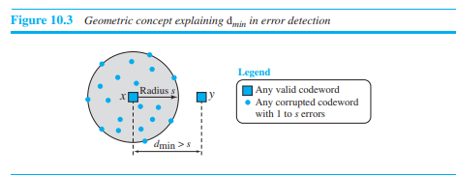
We can look at this criteria geometrically. Let us assume that the sent code word x is at the center of a circle with radius s. All received code words that are created by 0 to s errors are points inside the circle or on the perimeter of the circle. All other valid code words must be outside the circle, as shown in Figure 10.3. This means that dmin must be an integer greater than s or dmin = s + 1.

Slide 20
Linear Block Codes
Almost all block codes used today belong to a subset of block codes called linear block codes.
The use of nonlinear block codes for error detection and correction is not as widespread because their structure makes theoretical analysis and implementation difficult.
We therefore concentrate on linear block codes. The formal definition of linear block codes requires the knowledge of abstract algebra (particularly Galois fields), which is beyond the scope of this book.
We therefore give an informal definition. For our purposes, a linear block code is a code in which the exclusive OR (addition modulo-2) of two valid code words creates another valid code word.

Slide 21
Parity-Check Code
Perhaps the most familiar error-detecting code is the parity-check code. This code is a linear block code. In this code, a k-bit data word is changed to an n-bit code word where n = k + 1. The extra bit, called the parity bit, is selected to make the total number of 1s in the code word even. Although some implementations specify an odd number of 1s, we discuss the even case. The minimum Hamming distance for this category is dmin = 2, which means that the code is a single-bit error-detecting code. Our first code (Table 10.1) is a parity-check code (k = 2 and n = 3). The code in Table 10.2 is also a parity-check code with k = 4 and n = 5.

Slide 22
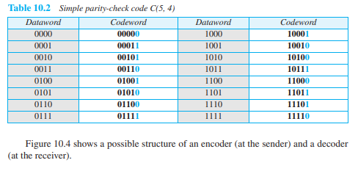

Slide 23
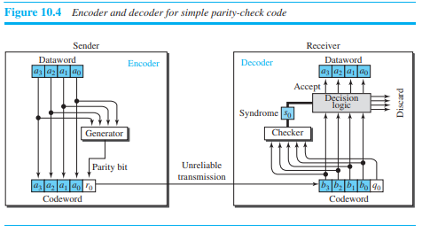

Slide 24
The calculation is done in modular arithmetic (see Appendix E). The encoder uses a generator that takes a copy of a 4-bit dataword (a0, a1, a2, and a3) and generates a parity bit r0. The dataword bits and the parity bit create the 5-bit codeword. The parity bit that is added makes the number of 1s in the codeword even. This is normally done by adding the 4 bits of the dataword (modulo-2); the result is the parity bit. In other words,
r0 = a3 + a2 + a1 + a0 (modulo-2)
If the number of 1s is even, the result is 0; if the number of 1s is odd, the result is 1. In both cases, the total number of 1s in the codeword is even. The sender sends the codeword, which may be corrupted during transmission. The receiver receives a 5-bit word. The checker at the receiver does the same thing as the generator in the sender with one exception: The addition is done over all 5 bits. The result which is called the syndrome, is just 1 bit. The syndrome is 0 when the number of 1s in the received codeword is even; otherwise, it is 1.

Slide 25
S0= b3+b2+ b1+ b0+ q0 (modulo-2)
The syndrome is passed to the decision logic analyzer. If the syndrome is 0, there is no detectable error in the received codeword; the data portion of the received codeword is accepted as the dataword; if the syndrome is 1, the data portion of the received codeword is discarded. The dataword is not created.

Slide 26

CYCLIC CODES
Cyclic codes are special linear block codes with one extra property. In a cyclic code, if a codeword is cyclically shifted (rotated), the result is another codeword. For example, if 1011000 is a codeword and we cyclically left-shift, then 0110001 is also a codeword. In this case, if we call the bits in the first word a0 to a6, and the bits in the second word b0 to b6, we can shift the bits by using the following:

Slide 27
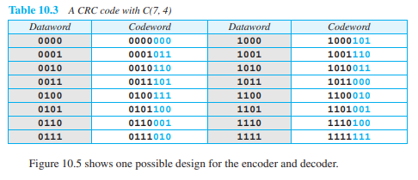
Cyclic Redundancy Check
We can create cyclic codes to correct errors. However, the theoretical background required is beyond the scope of this book. In this section, we simply discuss a subset of cyclic codes called the cyclic redundancy check (CRC), which is used in networks such as LANs and WANs. Table 10.3 shows an example of a CRC code. We can see both the linear and cyclic properties of this code.

Slide 28
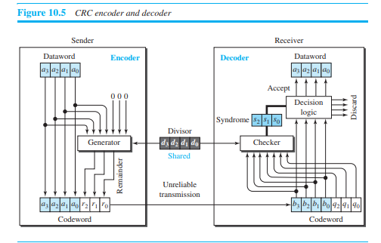

Slide 29
In the encoder, the dataword has k bits (4 here); the codeword has n bits (7 here). The size of the dataword is augmented by adding n − k (3 here) 0s to the right-hand side of the word. The n-bit result is fed into the generator. The generator uses a divisor of size n − k + 1 (4 here), predefined and agreed upon. The generator divides the augmented dataword by the divisor (modulo-2 division). The quotient of the division is discarded; the remainder (r2r1r0) is appended to the dataword to create the codeword. The decoder receives the codeword (possibly corrupted in transition). A copy of all n bits is fed to the checker, which is a replica of the generator. The remainder produced by the checker is a syndrome of n − k (3 here) bits, which is fed to the decision logic analyzer. The analyzer has a simple function. If the syndrome bits are all 0s, the 4 leftmost bits of the codeword are accepted as the dataword (interpreted as no error); otherwise, the 4 bits are discarded (error).

Slide 30
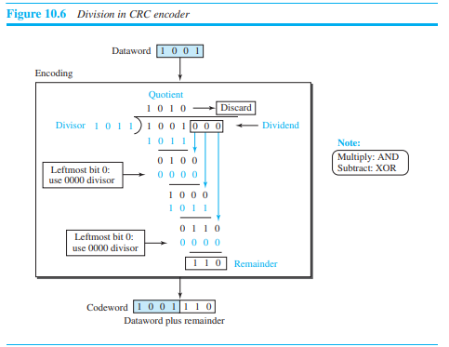
Encoder
Let us take a closer look at the encoder. The encoder takes a dataword and augments it with n − k number of 0s. It then divides the augmented dataword by the divisor, as shown in Figure 10.6.

Slide 31
The process of modulo-2 binary division is the same as the familiar division process we use for decimal numbers. However, addition and subtraction in this case are the same; we use the XOR operation to do both. As in decimal division, the process is done step by step. In each step, a copy of the divisor is XORed with the 4 bits of the dividend. The result of the XOR operation (remainder) is 3 bits (in this case), which is used for the next step after 1 extra bit is pulled down to make it 4 bits long. There is one important point we need to remember in this type of division. If the leftmost bit of the dividend (or the part used in each step) is 0, the step cannot use the regular divisor; we need to use an all-0s divisor. When there are no bits left to pull down, we have a result. The 3-bit remainder forms the check bits (r2, r1, and r0). They are appended to the dataword to create the codeword.

Slide 32
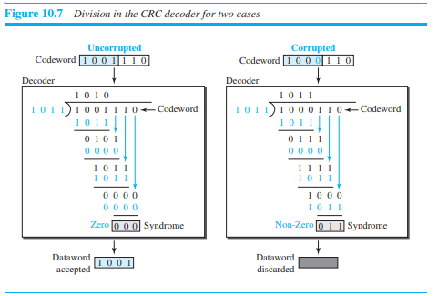
Decoder
The codeword can change during transmission. The decoder does the same division process as the encoder. The remainder of the division is the syndrome. If the syndrome is all 0s, there is no error with a high probability; the dataword is separated from the received codeword and accepted. Otherwise, everything is discarded. Figure 10.7 shows two cases: The left-hand figure shows the value of the syndrome when no error has occurred; the syndrome is 000. The right-hand part of the figure shows the case in which there is a single error. The syndrome is not all 0s (it is 011).

Slide 33
Divisor
We may be wondering how the divisor 1011 is chosen. This depends on the expectation we have from the code. We will show some standard divisors later in the chapter (Table 10.4) after we discuss polynomials.

Slide 34

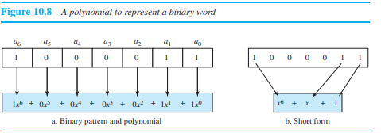
Polynomials
A better way to understand cyclic codes and how they can be analyzed is to represent them as polynomials. Again, this section is optional. A pattern of 0s and 1s can be represented as a polynomial with coefficients of 0 and 1. The power of each term shows the position of the bit; the coefficient shows the value of the bit. Figure 10.8 shows a binary pattern and its polynomial representation. In Figure 10.8a we show how to translate a binary pattern into a polynomial; in Figure 10.8b we show how the polynomial can be shortened by removing all terms with zero coefficients and replacing x1 by x and x0 by 1. Figure 10.8 shows one immediate benefit; a 7-bit pattern can be replaced by three terms. The benefit is even more conspicuous when we have a polynomial such as

Slide 35
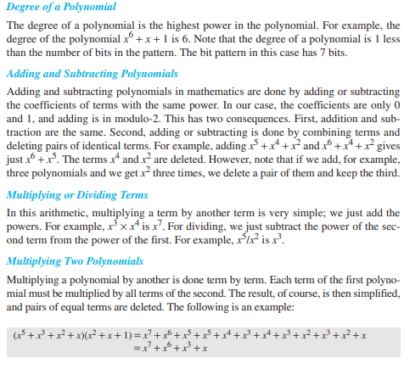

Slide 36
Dividing One Polynomial by Another
Division of polynomials is conceptually the same as the binary division we discussed for an encoder. We divide the first term of the dividend by the first term of the divisor to get the first term of the quotient. We multiply the term in the quotient by the divisor and subtract the result from the dividend. We repeat the process until the dividend degree is less than the divisor degree. We will show an e
Shifting A binary pattern is often shifted a number of bits to the right or left. Shifting to the left means adding extra 0s as rightmost bits; shifting to the right means deleting some rightmost bits. Shifting to the left is accomplished by multiplying each term of the polynomial by xm(power), where m is the number of shifted bits; shifting to the right is accomplished by dividing each term of the polynomial by xm. The following shows shifting to the left and to the right. Note that we do not have negative powers in the polynomial representation.xample of division later in this chapter.

Slide 37
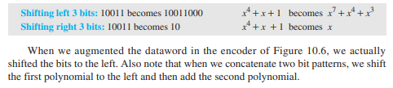

Slide 38
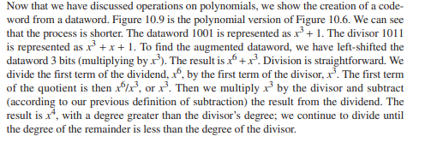
Cyclic Code Encoder Using Polynomials

Slide 39
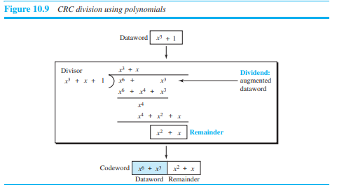

Slide 40
Contd..
It can be seen that the polynomial representation can easily simplify the operation of division in this case, because the two steps involving all-0s divisors are not needed here. (Of course, one could argue that the all-0s divisor step can also be eliminated in binary division.) In a polynomial representation, the divisor is normally referred to as the generator polynomial t(x).

Slide 41
Cyclic Code Analysis
We can analyze a cyclic code to find its capabilities by using polynomials. We define the following, where f(x) is a polynomial with binary coefficients. If s(x) is not zero, then one or more bits is corrupted. However, if s(x) is zero, either no bit is corrupted or the decoder failed to detect any errors. (Note t
In a cyclic code,
If s(x) ¦ 0, one or more bits is corrupted.
2. If s(x) = 0, either
a. No bit is corrupted, or
b. Some bits are corrupted, but the decoder failed to detect them.hat ¦ means divide).

Slide 42

In our analysis we want to find the criteria that must be imposed on the generator, g(x) to detect the type of error we especially want to be detected.
Let us first find the relationship among the sent code word, error, received code word, and the generator. We can say Received co.
In other words, the received codeword is the sum of the sent codeword and the error. The receiver divides the received codeword by g(x) to get the syndrome.
We can write this word as=
The first term at the right-hand side of the equality has a remainder of zero (according to the definition of codeword). So the syndrome is actually the remainder of the second term on the right-hand side. If this term does not have a remainder (syndrome = 0), either e(x) is 0 or e(x) is divisible by g(x). We do not have to worry about the first case (there is no error); the second case is very important. Those errors that are divisible by g(x) are not caught.

Slide 43
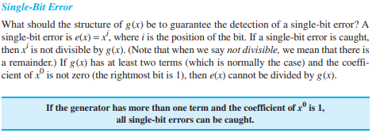

Slide 44
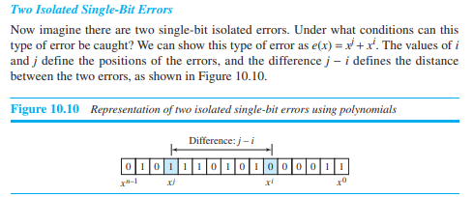

Slide 45
Data Link Control (DLC)
DLC SERVICES:
The data link control (DLC) deals with procedures for communication between two adjacent nodes—node-to-node communication—no matter whether the link is dedicated or broadcast.
Data link control functions include framing and flow and error control.
In this section, we first discuss framing, or how to organize the bits that are carried by the physical layer.
We then discuss flow and error control.

Slide 46
Framing
Data transmission in the physical layer means moving bits in the form of a signal from the source to the destination.
The physical layer provides bit synchronization to ensure that the sender and receiver use the same bit durations and timing. We discussed the physical layer in Part II of the book. The data-link layer, on the other hand, needs to pack bits into frames, so that each frame is distinguishable from another.
Our postal system practices a type of framing. The simple act of inserting a letter into an envelope separates one piece of information from another; the envelope serves as the delimiter.
In addition, each envelope defines the sender and receiver addresses, which is necessary since the postal system is a many-to-many carrier facility.
Framing in the data-link layer separates a message from one source to a destination by adding a sender address and a destination address. The destination address defines where the packet is to go; the sender address helps the recipient acknowledge the receipt.

Slide 47
Frame Size
Frames can be of fixed or variable size. In fixed-size framing, there is no need for defining the boundaries of the frames; the size itself can be used as a delimiter.
An example of this type of framing is the ATM WAN, which uses frames of fixed size called cells.
We discuss ATM in Chapter 14. Our main discussion in this chapter concerns variable-size framing, prevalent in local-area networks.
In variable-size framing, we need a way to define the end of one frame and the beginning of the next. Historically, two approaches were used for this purpose: a character-oriented approach and a bit-oriented approach.

Slide 48
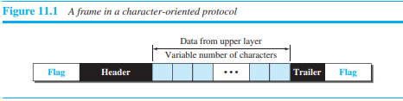
Character-Oriented Framing :
In character-oriented (or byte-oriented) framing, data to be carried are 8-bit characters from a coding system such as ASCII (see Appendix A).
The header, which normally carries the source and destination addresses and other control information, and the trailer, which carries error detection redundant bits, are also multiples of 8 bits.
To separate one frame from the next, an 8-bit (1-byte) flag is added at the beginning and the end of a frame. The flag, composed of protocol-dependent special characters, signals the start or end of a frame. Figure 11.1 shows the format of a frame in a character-oriented protocol.

Slide 49
Character-oriented framing was popular when only text was exchanged by the data-link layers.
The flag could be selected to be any character not used for text communication. Now, however, we send other types of information such as graphs, audio, and video; any character used for the flag could also be part of the information.
If this happens, the receiver, when it encounters this pattern in the middle of the data, thinks it has reached the end of the frame.
To fix this problem, a byte-stuffing strategy was added to character-oriented framing. In byte stuffing (or character stuffing), a special byte is added to the data section of the frame when there is a character with the same pattern as the flag. The data section is stuffed with an extra byte.
This byte is usually called the escape character (ESC) and has a predefined bit pattern. Whenever the receiver encounters the ESC character, it removes it from the data section and treats the next character as data, not as a delimiting flag. Figure 11.2 shows the situation.

Slide 50
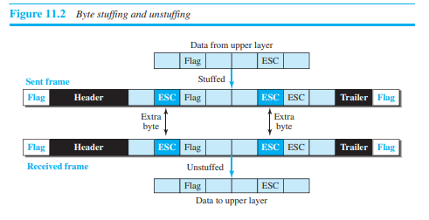

Slide 51
Byte stuffing by the escape character allows the presence of the flag in the data section of the frame, but it creates another problem.
What happens if the text contains one or more escape characters followed by a byte with the same pattern as the flag? Thereceiver removes the escape character, but keeps the next byte, which is incorrectly interpreted as the end of the frame.
To solve this problem, the escape characters that are part of the text must also be marked by another escape character. In other words, if the escape character is part of the text, an extra one is added to show that the second one is part of the text.
Character-oriented protocols present another problem in data communications. The universal coding systems in use today, such as Unicode, have 16-bit and 32-bit characters that conflict with 8-bit characters.
We can say that, in general, the tendency is moving toward the bit-oriented protocols that we discuss next.

Slide 52
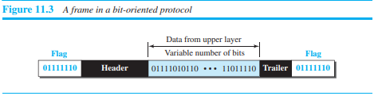
Bit-Oriented Framing
In bit-oriented framing, the data section of a frame is a sequence of bits to be interpreted by the upper layer as text, graphic, audio, video, and so on. However, in addition to headers (and possible trailers), we still need a delimiter to separate one frame from the other. Most protocols use a special 8-bit pattern flag, 01111110, as the delimiter to define the beginning and the end of the frame, as shown in Figure 11.3

Slide 53
This flag can create the same type of problem we saw in the character-oriented protocols. That is, if the flag pattern appears in the data, we need to somehow inform the receiver that this is not the end of the frame. We do this by stuffing 1 single bit (instead of 1 byte) to prevent the pattern from looking like a flag. The strategy is called bit stuffing. In bit stuffing, if a 0 and five consecutive 1 bits are encountered, an extra 0 is added. This extra stuffed bit is eventually removed from the data by the receiver. Note that the extra bit is added after one 0 followed by five 1s regardless of the value of the next bit. This guarantees that the flag field sequence does not inadvertently appear in the frame.

Slide 54
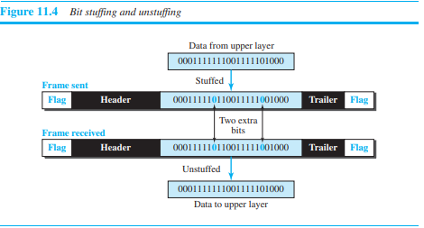
Figure 11.4 shows bit stuffing at the sender and bit removal at the receiver. Note that even if we have a 0 after five 1s, we still stuff a 0. The 0 will be removed by the receiver. This means that if the flaglike pattern 01111110 appears in the data, it will change to 011111010 (stuffed) and is not mistaken for a flag by the receiver. The real flag 01111110 is not stuffed by the sender and is recognized by the receiver.

Slide 55
Flow and Error Control
We briefly defined flow and error control in Chapter 9; we elaborate on these two issues here. One of the responsibilities of the data-link control sublayer is flow and error control at the data-link layer.
Flow Control
Whenever an entity produces items and another entity consumes them, there should be a balance between production and consumption rates.
If the items are produced faster than they can be consumed, the consumer can be overwhelmed and may need to discard some items.
If the items are produced more slowly than they can be consumed, the consumer must wait, and the system becomes less efficient. Flow control is related to the first issue. We need to prevent losing the data items at the consumer site.
In communication at the data-link layer, we are dealing with four entities: network and data-link layers at the sending node and network and data-link layers at the receiving node.
Although we can have a complex relationship with more than one producer and consumer (as we will see in Chapter 23), we ignore the relationships between networks and data-link layers and concentrate on the relationship between two data-link layers, as shown in Figure 11.5.

Slide 56
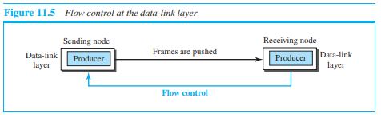

Slide 57
The figure shows that the data-link layer at the sending node tries to push frames toward the data-link layer at the receiving node. If the receiving node cannot process and deliver the packet to its network at the same rate that the frames arrive, it becomes overwhelmed with frames. Flow control in this case can be feedback from the receiving node to the sending node to stop or slow down pushing frames.
Buffers
Although flow control can be implemented in several ways, one of the solutions is normally to use two buffers; one at the sending data-link layer and the other at the receiving data-link layer. A buffer is a set of memory locations that can hold packets at the sender and receiver. The flow control communication can occur by sending signals from the consumer to the producer. When the buffer of the receiving data-link layer is full, it informs the sending data-link layer to stop pushing frames.

Slide 58
Connectionless and Connection-Oriented
A DLC protocol can be either connectionless or connection-oriented. We will discuss this issue very briefly here, but we return to this topic in the network and transport layer.
Connectionless Protocol
In a connectionless protocol, frames are sent from one node to the next without any relationship between the frames; each frame is independent. Note that the term connectionless here does not mean that there is no physical connection (transmission medium) between the nodes; it means that there is no connection between frames. The frames are not numbered and there is no sense of ordering. Most of the data-link protocols for LANs are connectionless protocols.
Connection-Oriented Protocol
In a connection-oriented protocol, a logical connection should first be established between the two nodes (setup phase). After all frames that are somehow related to each other are transmitted (transfer phase), the logical connection is terminated (teardown phase). In this type of communication, the frames are numbered and sent in order. If they are not received in order, the receiver needs to wait until all frames belonging to the same set are received and then deliver them in order to the network layer. Connectionoriented protocols are rare in wired LANs, but we can see them in some point-to-point protocols, some wireless LANs, and some WANs.

Slide 59
DATA-LINK LAYER PROTOCOLS
Traditionally four protocols have been defined for the data-link layer to deal with flow and error control: Simple, Stop-and-Wait, Go-Back-N, and Selective-Repeat.
Although the first two protocols still are used at the data-link layer, the last two have disappeared. We therefore briefly discuss the first two protocols in this chapter, in which we need to understand some wired and wireless LANs.
The behavior of a data-link-layer protocol can be better shown as a finite state machine (FSM). An FSM is thought of as a machine with a finite number of states.
The machine is always in one of the states until an event occurs.
Each event is associated with two reactions: defining the list (possibly empty) of actions to be performed and determining the next state (which can be the same as the current state).
One of the states must be defined as the initial state, the state in which the machine starts when it turns on. In Figure 11.6, we show an example of a machine using FSM.
We have used rounded-corner rectangles to show states, colored text to show events, and regular black text to show actions.
A horizontal line is used to separate the event from the actions, although later we replace the horizontal line with a slash. The arrow shows the movement to the next state.

Slide 60
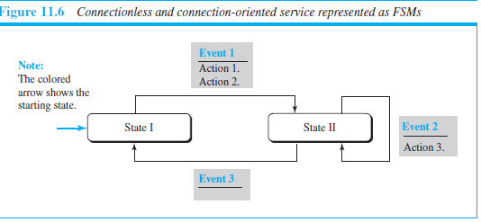
The figure shows a machine with three states. There are only three possible events and three possible actions. The machine starts in state I. If event 1 occurs, the machine performs actions 1 and 2 and moves to state II. When the machine is in state II, two events may occur. If event 1 occurs, the machine performs action 3 and remains in the same state, state II. If event 3 occurs, the machine performs no action, but move to state I.

Slide 61
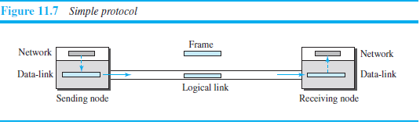
Simple Protocol
Our first protocol is a simple protocol with neither flow nor error control. We assume that the receiver can immediately handle any frame it receives. In other words, the receiver can never be overwhelmed with incoming frames. Figure 11.7 shows the layout for this protocol.

Slide 62
Contd..
The data-link layer at the sender gets a packet from its network layer, makes a frame out of it, and sends the frame. The data-link layer at the receiver receives a frame from the link, extracts the packet from the frame, and delivers the packet to its network layer. The data-link layers of the sender and receiver provide transmission services for their network layers.

Slide 63
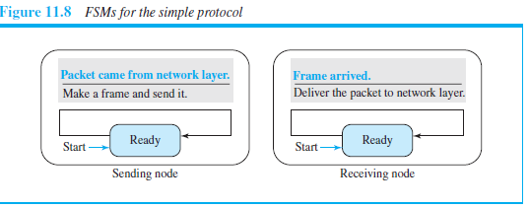
FSMs
The sender site should not send a frame until its network layer has a message to send. The receiver site cannot deliver a message to its network layer until a frame arrives. We can show these requirements using two FSMs. Each FSM has only one state, the ready state. The sending machine remains in the ready state until a request comes from the process in the network layer. When this event occurs, the sending machine encapsulates the message in a frame and sends it to the receiving machine. The receiving machine remains in the ready state until a frame arrives from the sending machine. When this event occurs, the receiving machine decapsulates the message out of the frame and delivers it to the process at the network layer. Figure 11.8 shows the FSMs for the simple protocol. We’ll see more in Chapter 23, which uses this protocol.

Slide 64
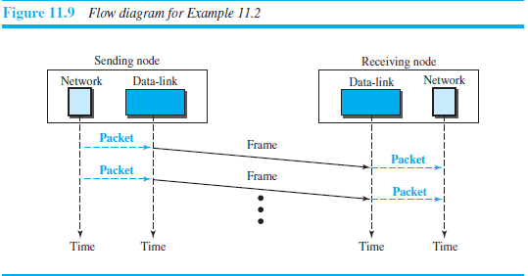
Figure 11.9 shows an example of communication using this protocol. It is very simple. The sender sends frames one after another without even thinking about the receiver.

Slide 65
Stop-and-Wait Protocol
Our second protocol is called the Stop-and-Wait protocol, which uses both flow and error control.
We show a primitive version of this protocol here, but we discuss the more sophisticated version in Chapter 23 when we have learned about sliding windows.
In this protocol, the sender sends one frame at a time and waits for an acknowledgment before sending the next one.
To detect corrupted frames, we need to add a CRC (see Chapter 10) to each data frame. When a frame arrives at the receiver site, it is checked. If its CRC is incorrect, the frame is corrupted and silently discarded.
The silence of the receiver is a signal for the sender that a frame was either corrupted or lost. Every time the sender sends a frame, it starts a timer.
If an acknowledgment arrives before the timer expires, the timer is stopped and the sender sends the next frame (if it has one to send). If the timer expires, the sender resends the previous frame, assuming that the frame was either lost or corrupted.
This means that the sender needs to keep a copy of the frame until its acknowledgment arrives. When the corresponding acknowledgment arrives, the sender discards the copy and sends the next frame if it is ready.
Figure 11.10 shows the outline for the Stop-and-Wait protocol. Note that only one frame and one acknowledgment can be in the channels at any time.

Slide 66
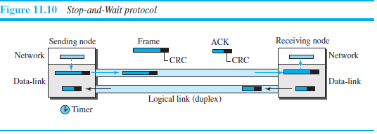

Slide 67
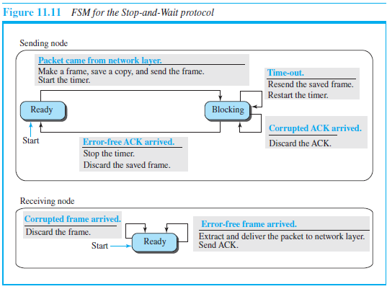
FSMs
Figure 11.11 shows the FSMs for our primitive Stop-and-Wait protocol

Slide 68
We describe the sender and receiver states below.
Sender States
The sender is initially I
Ready State. When the sender is in this state, it is only waiting for a packet from the network layer. If a packet comes from the network layer, the sender creates a frame, saves a copy of the frame, starts the only timer and sends the frame. The sender then moves to the blocking state.
❑ Blocking State. When the sender is in this state, three events can occur:
a. If a time-out occurs, the sender resends the saved copy of the frame and restarts the timer.
b. If a corrupted ACK arrives, it is discarded.
c. If an error-free ACK arrives, the sender stops the timer and discards the saved
copy of the frame. It then moves to the ready state.n the ready state, but it can move between the ready and blocking state.
Receiver
The receiver is always in the ready state. Two events may occur:
a. If an error-free frame arrives, the message in the frame is delivered to the network layer and an ACK is sent.
b. If a corrupted frame arrives, the frame is discarded.

Slide 69
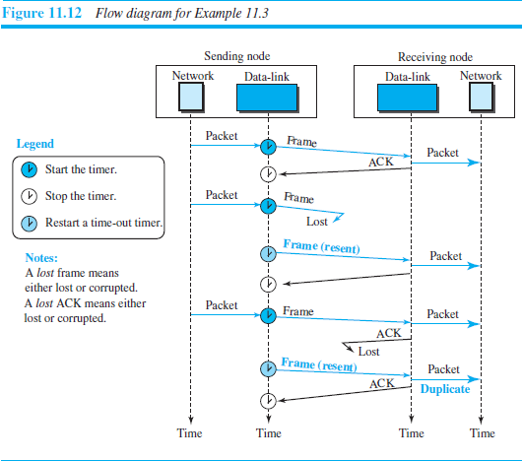
FSMs with Sequence and Acknowledgment Numbers
We can change the FSM in Figure 11.11 to include the sequence and acknowledgment numbers, but we leave this as a problem at the end of the chapter.

Slide 70
Piggybacking
The two protocols we discussed in this section are designed for unidirectional communication, in which data is flowing only in one direction although the acknowledgment may travel in the other direction.
Protocols have been designed in the past to allow data to flow in both directions.
However, to make the communication more efficient, the data in one direction is piggybacked with the acknowledgment in the other direction. In other words, when node A is sending data to node B, Node A also acknowledges the data received from node B.
Because piggybacking makes communication at the datalink layer more complicated, it is not a common practice.
Note: Piggybacking is the technique of delaying outgoing acknowledgment and attaching it to the next data packet.

Slide 71
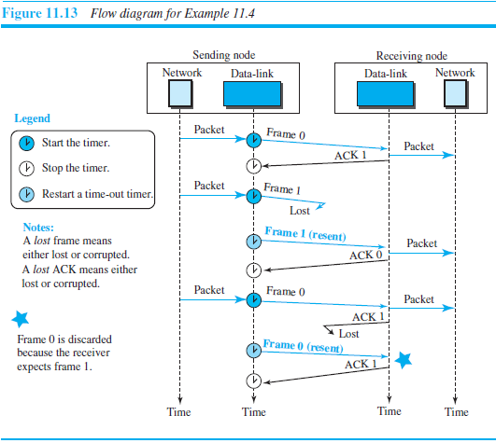
HDLC
High-level Data Link Control (HDLC) is a bit-oriented protocol for communication over point-to-point and multipoint links. It implements the Stop-and-Wait protocol we discussed earlier. Although this protocol is more a theoretical issue than practical, most of the concept defined in this protocol is the basis for other practical protocols such as PPP, which we discuss next, or the Ethernet protocol,

Slide 72
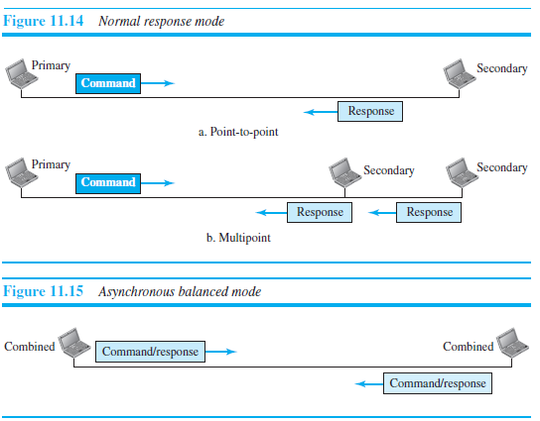
Configurations and Transfer Modes
HDLC provides two common transfer modes that can be used in different configurations: normal response mode (NRM) and asynchronous balanced mode (ABM). In normal response mode (NRM), the station configuration is unbalanced.
We have one primary station and multiple secondary stations. A primary station can send commands; a secondary station can only respond. The NRM is used for both point-to-point and multipoint links, as shown in Figure 11.14. In ABM, the configuration is balanced. The link is point-to-point, and each station can function as a primary and a secondary (acting as peers), as shown in Figure 11.15. This is the common mode today.

Slide 73
Framing
To provide the flexibility necessary to support all the options possible in the modes and configurations just described, HDLC defines three types of frames: information frames (I-frames), supervisory frames (S-frames), and unnumbered frames (U-frames).
Each type of frame serves as an envelope for the transmission of a different type of message.
I-frames are used to data-link user data and control information relating to user data (piggybacking).
S-frames are used only to transport control information.
U-frames are reserved for system management.
Information carried by U-frames is intended for managing the link itself.
Each frame in HDLC may contain up to six fields, as shown in Figure 11.16: a beginning flag field, an address field, a control field, an information field, a frame check sequence (FCS) field, and an ending flag field. In multiple-frame transmissions, the ending lag of one frame can serve as the beginning flag of the next frame.

Slide 74
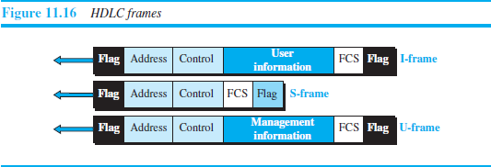

Slide 75
Let us now discuss the fields and their use in different frame types.
❑ Flag field. This field contains synchronization pattern 01111110, which identifies both the beginning and the end of a frame.
❑ Address field. This field contains the address of the secondary station. If a primary station created the frame, it contains a to address. If a secondary station creates the frame, it contains a from address. The address field can be one byte or several bytes long, depending on the needs of the network.
❑ Control field. The control field is one or two bytes used for flow and error control. The interpretation of bits are discussed later.
❑ Information field. The information field contains the user’s data from the network layer or management information. Its length can vary from one network to another.
❑ FCS field. The frame check sequence (FCS) is the HDLC error detection field. It can contain either a 2- or 4-byte CRC.

Slide 76
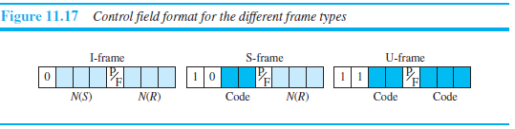
The control field determines the type of frame and defines its functionality. So let us discuss the format of this field in detail. The format is specific for the type of frame, as shown in Figure 11.17.

Slide 77
Control Field for I-Frames
I-frames are designed to carry user data from the network layer. In addition, they can include flow- and error-control information (piggybacking).
The subfields in the control field are used to define these functions.
The first bit defines the type. If the first bit of the control field is 0, this means the frame is an I-frame. The next 3 bits, called N(S), define the sequence number of the frame. Note that with 3 bits, we can define a sequence number between 0 and 7.
The last 3 bits, called N(R), correspond to the acknowledgment number when piggybacking is used.
The single bit between N(S) and N(R) is called the P/F bit. The P/F field is a single bit with a dual purpose. It has meaning only when it is set (bit = 1) and can mean poll or final.
It means poll when the frame is sent by a primary station to a secondary (when the address field contains the address of the receiver). It means final when the frame is sent by a secondary to a primary (when the address field contains the address of the sender).

Slide 78
Control Field for S-Frames
Supervisory frames are used for flow and error control whenever piggybacking is either impossible or inappropriate. S-frames do not have information fields. If the first 2 bits of the control field are 10, this means the frame is an S-frame. The last 3 bits, called N(R), correspond to the acknowledgment number (ACK) or negative acknowledgment number (NAK), depending on the type of S-frame. The 2 bits called code are used to define the type of S-f
Receive ready (RR). If the value of the code subfield is 00, it is an RR S-frame. This kind of frame acknowledges the receipt of a safe and sound frame or group of frames. In this case, the value of the N(R) field defines the acknowledgment number.rame itself. With 2 bits, we can have four types of S-frames, as described below:

Slide 79
Receive not ready (RNR). If the value of the code subfield is 10, it is an RNR S frame. This kind of frame is an RR frame with additional functions. It acknowledges the receipt of a frame or group of frames, and it announces that the receiver is busy and cannot receive more frames. It acts as a kind of congestion-control mechanism by asking the sender to slow down. The value of N(R) is the acknowledgment number.
Reject (REJ). If the value of the code subfield is 01, it is an REJ S-frame. This is a NAK frame, but not like the one used for Selective Repeat ARQ. It is a NAK that can be used in Go-Back-N ARQ to improve the efficiency of the process by informing the sender, before the sender timer expires, that the last frame is lost or damaged. The value of N(R) is the negative acknowledgment number.
Selective reject (SREJ). If the value of the code subfield is 11, it is an SREJ Sframe. This is a NAK frame used in Selective Repeat ARQ. Note that the HDLC Protocol uses the term selective reject instead of selective repeat. The value of N(R) is the negative acknowledgment number.

Slide 80
Control Field for U-Frames
Unnumbered frames are used to exchange session management and control information between connected devices. Unlike S-frames, U-frames contain an information field, but one used for system management information, not user data. As with S-frames, however, much of the information carried by U-frames is contained in codes included in the control field. U-frame codes are divided into two sections: a 2-bit prefix before the P/ F bit and a 3-bit suffix after the P/F bit. Together, these two segments (5 bits) can be used to create up to 32 different types of U-frames.

Slide 81
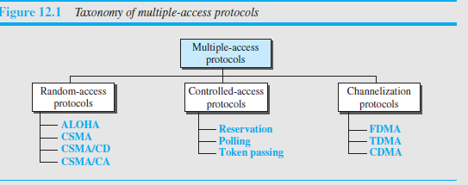
Media Access Control (MAC)
when nodes or stations are connected and use a common link, called a multipoint or broadcast link, we need a multiple-access protocol to coordinate access to the link.
The problem of controlling the access to the medium is similar to the rules of speaking in an assembly.
The procedures guarantee that the right to speak is upheld and ensure that two people do not speak at the same time, do not interrupt each other, do not monopolize the discussion, and so on. Many protocols have been devised to handle access to a shared link.
All of these protocols belong to a sublayer in the data-link layer called media access control (MAC). We categorize them into three groups, as shown in Figure 12.1.

Slide 82
RANDOM ACCESS
In random-access or contention methods, no station is superior to another station and none is assigned control over another.
At each instance, a station that has data to send uses a procedure defined by the protocol to make a decision on whether or not to send.
This decision depends on the state of the medium (idle or busy). In other words, each station can transmit when it desires on the condition that it follows the predefined procedure, including testing the state of the medium.
Two features give this method its name. First, there is no scheduled time for a station to transmit. Transmission is random among the stations.
That is why these methods are called random access. Second, no rules specify which station should sendnext. Stations compete with one another to access the medium. That is why these methods are also called contention methods.

Slide 83
ALOHA
ALOHA, the earliest random access method, was developed at the University of Hawaii in early 1970. It was designed for a radio (wireless) LAN, but it can be used on any shared medium. It is obvious that there are potential collisions in this arrangement. The medium is shared between the stations. When a station sends data, another station may attempt to do so at the same time. The data from the two stations collide and become garbled.
Pure ALOHA
The original ALOHA protocol is called pure ALOHA. This is a simple but elegant protocol.
The idea is that each station sends a frame whenever it has a frame to send (multiple access).
However, since there is only one channel to share, there is the possibility of collision between frames from different stations.
Figure 12.2 shows an example of frame collisions in pure ALOHA.

Slide 84
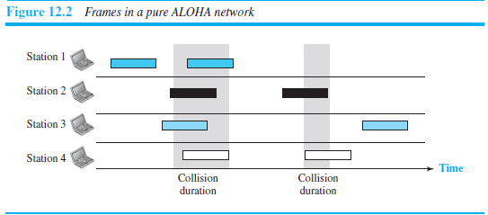

Slide 85
There are four stations (unrealistic assumption) that contend with one another for access to the shared channel.
The figure shows that each station sends two frames; there are a total of eight frames on the shared medium. Some of these frames collide because multiple frames are in contention for the shared channel.
Figure 12.2 shows that only two frames survive: one frame from station 1 and one frame from station 3. We need to mention that even if one bit of a frame coexists on the channel with one bit from another frame, there is a collision and both will be destroyed.
It is obvious that we need to resend the frames that have been destroyed during transmission. The pure ALOHA protocol relies on acknowledgments from the receiver. When a station sends a frame, it expects the receiver to send an acknowledgment.
If the acknowledgment does not arrive after a time-out period, the station assumes that the frame (or the acknowledgment) has been destroyed and resends the frame. A collision involves two or more stations. If all these stations try to resend their frames after the time-out, the frames will collide again.
Pure ALOHA dictates that when the time-out period passes, each station waits a random amount of time before resending its frame. The randomness will help avoid more collisions. We call this time the backoff time TB

Slide 86
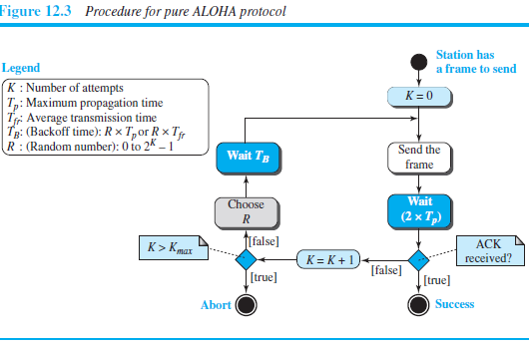

Slide 87
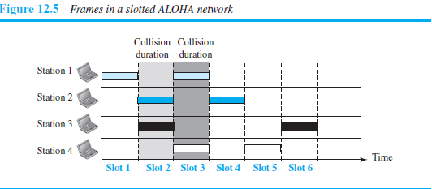
Slotted ALOHA
Pure ALOHA has a vulnerable time of 2 ⋅ Tfr. This is so because there is no rule that defines when the station can send. A station may send soon after another station has started or just before another station has finished. Slotted ALOHA was invented to improve the efficiency of pure ALOHA.
In slotted ALOHA we divide the time into slots of Tfr seconds and force the station to send only at the beginning of the time slot.
Figure 12.5 shows an example of frame collisions in slotted ALOHA.

Slide 88
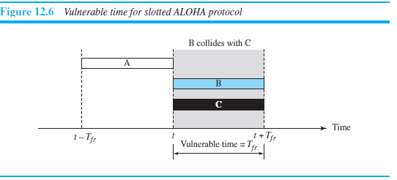
Because a station is allowed to send only at the beginning of the synchronized time slot, if a station misses this moment, it must wait until the beginning of the next time slot. This means that the station which started at the beginning of this slot has already finished sending its frame. Of course, there is still the possibility of collision if two stations try to send at the beginning of the same time slot. However, the vulnerable time is now reduced to one-h
alf, equal to Tfr. Figure 12.6 shows the situation.

Slide 89
Throughput
It can be proven that the average number of successful transmissions for slotted ALOHA is
S = G ⋅ e−G(POW)
The maximum throughput Smax is 0.368, when G = 1. In other words, if one frame is generated during one frame transmission time, then 36.8 percent of these frames reach their destination successfully.
We expect G = 1 to produce maximum throughput because the vulnerable time is equal to the frame transmission time.
Therefore, if a station generates only one frame in this vulnerable time (and no other station generates a frame during this time), the frame will reach its destination successfully.

Slide 90
CSMA
To minimize the chance of collision and, therefore, increase the performance, the CSMA method was developed.
The chance of collision can be reduced if a station senses the medium before trying to use it. Carrier sense multiple access (CSMA) requires that each station first listen to the medium (or check the state of the medium) before sending.
In other words, CSMA is based on the principle “sense before transmit” or “listen before talk.” CSMA can reduce the possibility of collision, but it cannot eliminate it.
The reason for this is shown in Figure 12.7, a space and time model of a CSMA network. Stations are connected to a shared channel (usually a dedicated medium).
The possibility of collision still exists because of propagation delay; when a station sends a frame, it still takes time (although very short) for the first bit to reach every station and for every station to sense it.
In other words, a station may sense the medium and find it idle, only because the first bit sent by another station has not yet been received.

Slide 91
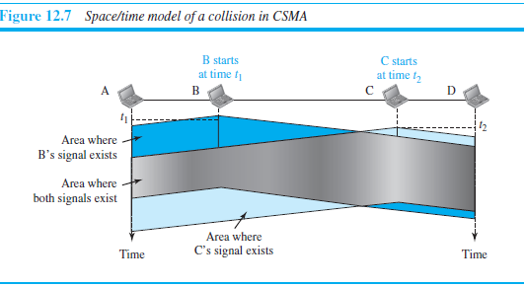
At time t1, station B senses the medium and finds it idle, so it sends a frame. At time t2 (t2 > t1), station C senses the medium and finds it idle because, at this time, the first bits from station B have not reached station C. Station C also sends a frame. The two signals collide and both frames are destroyed.

Slide 92
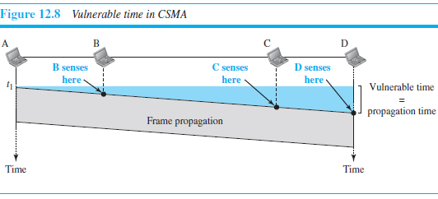
Vulnerable Time
The vulnerable time for CSMA is the propagation time Tp. This is the time needed for a signal to propagate from one end of the medium to the other.
When a station sends a frame and any other station tries to send a frame during this time, a collision will result. But if the first bit of the frame reaches the end of the medium, every station will already have heard the bit and will refrain from sending.
Figure 12.8 shows the worst case. The leftmost station, A, sends a frame at time t1, which reaches the rightmost station
, D, at time t1 + Tp. The gray area shows the vulnerable area in time and space.

Slide 93
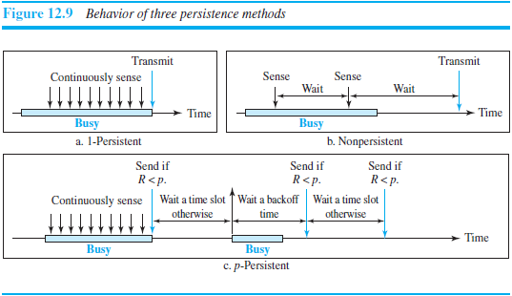
Persistence Methods
What should a station do if the channel is busy? What should a station do if the channel is idle? Three methods have been devised to answer these questions: the 1-persistent method, the nonpersistent method, and the p-persistent method. Figure 12.9 shows the behavior of three persistence methods when a station finds a channel busy.

Slide 94
1-Persistent
The 1-persistent method is simple and straightforward. In this method, after the station finds the line idle, it sends its frame immediately (with probability 1). This method has the highest chance of collision because two or more stations may find the line idle and send their frames immediately. We will see later that Ethernet uses this method.
Nonpersistent
In the nonpersistent method, a station that has a frame to send senses the line. If the line is idle, it sends immediately. If the line is not idle, it waits a random amount of time and then senses the line again. The nonpersistent approach reduces the chance of collision because it is unlikely that two or more stations will wait the same amount of time and retry to send simultaneously. However, this method reduces the efficiency of the network because the medium remains idle when there may be stations with frames to send.
p-Persistent
The p-persistent method is used if the channel has time slots with a slot duration equal to or greater than the maximum propagation time. The p-persistent approach combines the advantages of the other two strategies. It reduces the chance of collision and improves efficiency. In this method, after the station finds the line idle it follows these steps:

Slide 95
1. With probability p, the station sends its frame.
2. With probability q = 1 − p, the station waits for the beginning of the next time slot and checks the line again..
a. If the line is idle, it goes to step 1.
b. If the line is busy, it acts as though a collision has occurred and uses the backoff procedure.

Slide 96
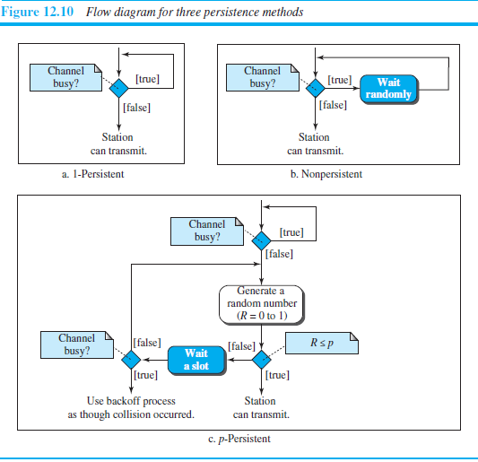

Slide 97
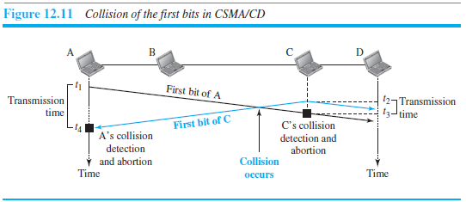
CSMA/CD
The CSMA method does not specify the procedure following a collision.
Carrier sense multiple access with collision detection (CSMA/CD) augments the algorithm to handle the collision.
In this method, a station monitors the medium after it sends a frame to see if the transmission was successful. If so, the station is finished.
If, however, there is a collision, the frame is sent again. To better understand CSMA/CD, let us look at the first bits transmitted by the two stations involved in the collision.
Although each station continues to send bits in the frame until it detects the collision, we show what happens as the first bits collide. In Figure 12.11, stations A and C are involved in the collision.

Slide 98
At time t1, station A has executed its persistence procedure and starts sending the bits of its frame.
At time t2, station C has not yet sensed the first bit sent by A. Station C executes its persistence procedure and starts sending the bits in its frame, which propagate both to the left and to the right.
The collision occurs sometime after time t2. Station C detects a collision at time t3 when it receives the first bit of A’s frame.
Station C immediately (or after a short time, but we assume immediately) aborts transmission.
Station A detects collision at time t4 when it receives the first bit of C’s frame; it also immediately aborts transmission. Looking at the figure, we see that A transmits for the duration t4 − t1; C transmits for the duration t3 − t2.
Now that we know the time durations for the two transmissions, we can show a more complete graph in Figure 12.12.

Slide 99
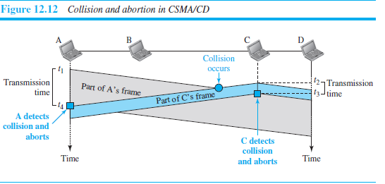

Slide 100
CSMA/CA
Carrier sense multiple access with collision avoidance (CSMA/CA) was invented for wireless networks. Collisions are avoided through the use of CSMA/CA’s three strategies: the interframe space, the contention window, and acknowledgments, as shown in Figure 12.15. We discuss RTS and CTS frames later.

Slide 101
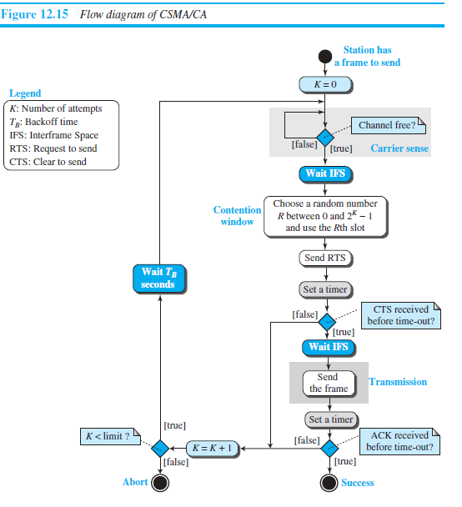

Slide 102
Contd..
Interframe Space (IFS). First, collisions are avoided by deferring transmission even if the channel is found idle. When an idle channel is found, the station does not send immediately.
It waits for a period of time called the interframe space or IFS.
Even though the channel may appear idle when it is sensed, a distant station may have already started transmitting.
The distant station’s signal has not yet reached this station.
Contention Window.
The contention window is an amount of time divided into slots.
A station that is ready to send chooses a random number of slots as its wait time.
The number of slots in the window changes according to the binary exponential backoff strategy.
This means that it is set to one slot the first time and then doubles each time the station cannot detect an idle channel after the IFS time.
This is very similar to the p-persistent method except that a random outcome defines the number of slots taken by the waiting station.

Slide 103
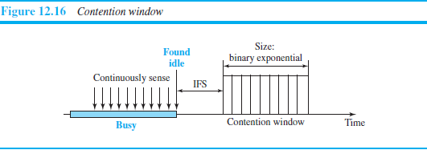
Acknowledgment. With all these precautions, there still may be a collision resulting in destroyed data. In addition, the data may be corrupted during the transmission. The positive acknowledgment and the time-out timer can help guarantee that the receiver has received the frame.

Slide 104
Frame Exchange Time Line
Figure 12.17 shows the exchange of data and control frames in time.
1. Before sending a frame, the source station senses the medium by checking the energy level at the carrier frequency.
a. The channel uses a persistence strategy with backoff until the channel is idle.
b. After the station is found to be idle, the station waits for a period of time called the DCF interframe space (DIFS); then the station sends a control frame called the request to send (RTS).
2. After receiving the RTS and waiting a period of time called the short interframe
space (SIFS), the destination station sends a control frame, called the clear to send (CTS), to the source station. This control frame indicates that the destination station is ready to receive data.
3. The source station sends data after waiting an amount of time equal to SIFS.
4. The destination station, after waiting an amount of time equal to SIFS, sends an acknowledgment to show that the frame has been received. Acknowledgment is needed in this protocol because the station does not have any means to check for the successful arrival of its data at the destination.

Slide 105
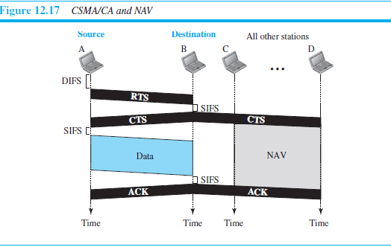

Slide 106
CONTROLLED ACCESS
In controlled access, the stations consult one another to find which station has the right to send. A station cannot send unless it has been authorized by other stations. We discuss three controlled-access methods.
Reservation
In the reservation method, a station needs to make a reservation before sending data. Time is divided into intervals. In each interval, a reservation frame precedes the data frames sent in that interval.
If there are N stations in the system, there are exactly N reservation mini slots in the reservation frame.
Each mini slot belongs to a station. When a station needs to send a data frame, it makes a reservation in its own mini slot.
The stations that have made reservations can send their data frames after the reservation frame. Figure 12.18 shows a situation with five stations and a five-mini slot reservation frame.
In the first interval, only stations 1, 3, and 4 have made reservations. In the second interval, only station 1 has made a reservation.

Slide 107
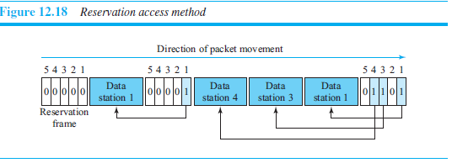

Slide 108

Polling
Polling works with topologies in which one device is designated as a primary station and the other devices are secondary stations.
All data exchanges must be made through the primary device even when the ultimate destination is a secondary device.
The primary device controls the link; the secondary devices follow its instructions.
It is up to the primary device to determine which device is allowed to use the channel at a given time.
The primary device, therefore, is always the initiator of a session (see Figure 12.19). This method uses poll and select functions to prevent collisions. However, the drawback is if the primary station fails, the system goes down.

Slide 109
Select
The select function is used whenever the primary device has something to send.
Remember that the primary controls the link. If the primary is neither sending nor receiving data, it knows the link is available.
If it has something to send, the primary device sends it. What it does not know, however, is whether the target device is prepared to receive.
So the primary must alert the secondary to the upcoming transmission and wait for an acknowledgment of the secondary’s ready status.
Before sending data, the primary creates and transmits a select (SEL) frame, one field of which includes theaddress of the intended secondary

Slide 110
Poll
The poll function is used by the primary device to solicit transmissions from the secondary devices.
When the primary is ready to receive data, it must ask (poll) each device in turn if it has anything to send.
When the first secondary is approached, it responds either with a NAK frame if it has nothing to send or with data (in the form of a data frame) if it does.
If the response is negative (a NAK frame), then the primary polls the next secondary in the same manner until it finds one with data to send.
When the response is positive (a data frame), the primary reads the frame and returns an acknowledgment (ACK frame), verifying its receipt.

Slide 111
Token Passing
In the token-passing method, the stations in a network are organized in a logical ring. In other words, for each station, there is a predecessor and a successor.
The predecessor is the station which is logically before the station in the ring; the successor is the station which is after the station in the ring.
The current station is the one that is accessing the channel now. The right to this access has been passed from the predecessor to the current station.
The right will be passed to the successor when the current station has no more data to send. But how is the right to access the channel passed from one station to another? In this method, a special packet called a token circulates through the ring.
The possession of the token gives the station the right to access the channel and send its data. When a station has some data to send, it waits until it receives the token from its predecessor.
It then holds the token and sends its data. When the station has no more data to send, it releases the token, passing it to the next logical station in the ring.

Slide 112

Logical Ring
In a token-passing network, stations do not have to be physically connected in a ring; the ring can be a logical one. Figure 12.20
shows four different physical topologies that can create a logical ring.

Slide 113
In the physical ring topology, when a station sends the token to its successor, the token cannot be seen by other stations; the successor is the next one in line.
This means that the token does not have to have the address of the next successor.
The problem with this topology is that if one of the links—the medium between two adjacent stations—fails, the whole system fails. The dual ring topology uses a second (auxiliary) ring which operates in the reverse direction compared with the main ring.
The second ring is for emergencies only (such as a spare tire for a car). If one of the links in the main ring fails, the system automatically combines the two rings to form a temporary ring.
After the failed link is restored, the auxiliary ring becomes idle again. Note that for this topology to work, each station needs to have two transmitter ports and two receiver ports.
The high-speed Token Ring networks called FDDI (Fiber Distributed Data Interface) and CDDI (Copper Distributed Data Interface) use this topology.
In the bus ring topology, also called a token bus, the stations are connected to a single cable called a bus. They, however, make a logical ring, because each station knows the address of its successor (and also predecessor for token management purposes).
When a station has finished sending its data, it releases the token and inserts the address of its successor in the token.
Only the station with the address matching the destination address of the token gets the token to access the shared media. The Token Bus LAN, standardized by IEEE, uses this topology.

